Slide 1
Detector construction: geometry and materials
Lecture 4

Slide 2
In this lecture
Learn how to create complex shapes - primitives, boolean operations and import from CAD
Learn more about materials - how compounds are modeled and how it works in transportation
Logical and physical volumes in more details - rotations, translations, many copies of one volume
Example - a clover HPGe detector, built from boolean solids and from .stl file!
Primary generator and physics list we take from lecture 3 - today we care only about geometry

Slide 3
DetectorConstruction
First let’s remember lecture 2:
To create a volume you need to create 3 objects
First describes its form - G4VSolid
Second describes its material - G4LogicalVolume
Third sets up its position and rotation - G4VPhysicalVolume
All volumes are placed inside the World volume, which is created first
World volume centered at the origin, no rotation, doesn't have mother volume
All volumes shouldn’t overlap or go outside the world - this can lead to an undefined behaviour of simulation!
Construct() - the method of G4VUserDetectorConstruction which is invoked during initialization of the simulation, it returns the world volume

Slide 4
Creation of the solid
There are many possible primitives to create: G4Box, G4Tubs, G4Cons - cone, G4Para - parallelepiped, G4Trd - trapezoid, etc.
Full list is here:
https://geant4-userdoc.web.cern.ch/UsersGuides/ForApplicationDeveloper/html/Detector/Geometry/geomSolids.html
You can also use logical operations between solids! For this you need:
Two solids - they shouldn’t be disjoint!
A Boolean operation: union, intersection or subtraction.
Optionally a transformation for the second solid.
Union will unite two solids; intersection will create a solid, which is equal to intersecting part of two solids; subtraction will subtract second volume from the first volume
Coincident surfaces of boolean solids in all boolean operations is not a good idea - so if you need to make a hole in the volume, make the subtracted solid go through the surface, not end exactly on it — e.g. subtract a 51 mm half-length tube from a 50 mm half-thickness box
Boolean created volumes can become quite expensive for navigation

Slide 5
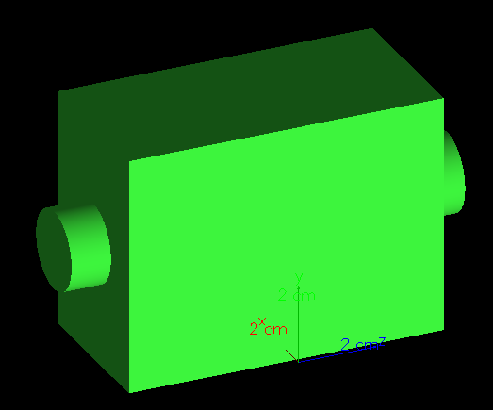
Boolean example
We can for example unite box and tube:
G4Box* box = new G4Box("Box",20*mm,30*mm,40*mm); // You set up half lengths - it’s 40×60×80 mm box
G4Tubs* cyl = new G4Tubs("Cylinder",0, 10*mm,50*mm,0,twopi); // 100 mm long cylinder with 10 mm radius
G4UnionSolid* union1 = new G4UnionSolid("Box+Cylinder", box, cyl);

Slide 6
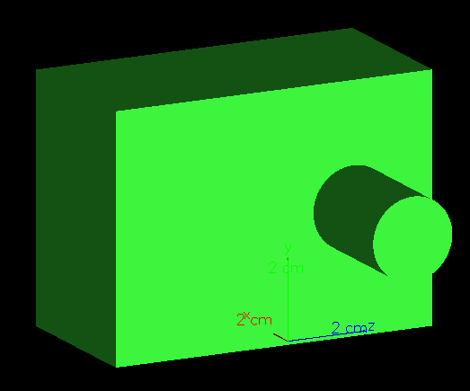
Boolean example
You can also add rotation and translation to the second object of boolean operation
G4RotationMatrix* yRot = new G4RotationMatrix; //Create identity rotation matrix
yRot->rotateY(90.*degree); //Calculate and set components which correspond to rotation around Y-axis
G4ThreeVector zTrans(0, 0, 20.*mm); //move by 20 mm in Z direction
G4UnionSolid* unionMoved = new G4UnionSolid("Box+CylinderMoved", box, cyl, yRot, zTrans);
This is passive transformation - it moves and rotates coordinate system of the second object!
For active transformation - rotation and moving of object itself - you can use:
G4RotationMatrix invRot = yRot->inverse();
G4Transform3D transform(invRot, zTrans);
G4UnionSolid* unionMoved2 = new G4UnionSolid("Box+CylinderMoved", box, cyl, transform);

Slide 7
Using CAD files to create solids
If your geometry is very complex - you can import it in Geant4 from CAD
Several possible ways, but typically you first need to convert your CAD (.step or .stp file) to set of tessellated surfaces in GDML or STL format
Some CAD software allows to export this directly, but you can also use some intermediate programs to do this - check this list!:
https://geant4-userdoc.web.cern.ch/UsersGuides/ForApplicationDeveloper/html/Detector/Geometry/geomSolids.html#importing-cad-models-as-tessellated-shapes
Then you import this shape and use as a solid!
We will go through an example which uses CADMesh library
https://github.com/christopherpoole/CADMesh
It uses .stl files to create solids!
This is typically quite expensive computationally: increases RAM usage and slows down navigation!
Tessellated files should be watertight to work properly - no holes, no hidden gaps

Slide 8
Materials
Again let’s remember lecture 2:
Materials are made from elements, elements are made from isotopes!
We create isotopes and set their atomic number, number of nucleons, mass per mole:
auto Pu242 = new G4Isotope("Pu242",94,242,242.059*g/mole);
auto Pu240 = new G4Isotope("Pu240",94,240,240.054*g/mole);
Then we create elements and set its isotopic mix (relative abundance by number of atoms):
auto elPu = new G4Element("Plutonium","Pu",2);
elPu->AddIsotope(Pu242,0.5);
elPu->AddIsotope(Pu240,0.5);

Slide 9
Materials
We can create material from molecule, setting up number of atoms
auto tarmat = new G4Material("UO2_target",11*g/cm3,2,kStateSolid);
(element, number of atoms - should be integer)
tarmat->AddElement(elU, 1);
tarmat->AddElement(elO, 2);
Also can just set up element fractions
auto tarmat2 = new G4Material("PuU_mat",11*g/cm3,2,kStateSolid);
(element, mass fraction - should be double)
tarmat2->AddElement(elPu, 0.5);
tarmat2->AddElement(elU, 0.5);
Materials can’t have 0 density - always set something for your vacuum volumes - G4_Galactic from NIST!
In simple cases and for some popular materials we can use NistManager, see the list here:
https://geant4.web.cern.ch/documentation/dev/bfad_html/ForApplicationDevelopers/Appendix/materialNames.html
auto nistManager = G4NistManager::Instance();
G4Material* Titanium = nistManager->FindOrBuildSimpleMaterial(22);
It will set up a natural composition of isotopes in accordance with NIST!

Slide 10
Materials
Materials are constant during simulation - they do not decay even if you build them from radioactive materials, they are not damaged, they are not ionized
Generally no explicit molecular structure or chemical bonds are modeled, the material is treated as homogeneous bulk matter of elements
Materials composition is used to calculate cross sections, give necessary properties to processes (number density for elements is the most important to get mean free paths) and sample possible secondaries
Let’s see how its done for a one process. For each i-th element in the material its number density is calculated: nᵢ = N_{av} · ρ · wᵢ / Aᵢ
where N_{av} - Avogadro number, ρ - density, wᵢ - mass fraction of i-th element of material, Aᵢ - molar mass of an i-th element
From it and microscopic cross section table σᵢ(E) of the i-th element - energy table of total macroscopic cross section Σ(E) of the process in the material is built:
Σ(E) = sum(nᵢ·σᵢ(E))
From this - table of the mean free path of the process in the material is built:
λ(E) = 1/Σ(E)
When process happens, the element for which it happens is sampled depending on its macroscopic cross section nᵢ·σᵢ(E)!

Slide 11
Materials
Also you can add optical properties - Geant4 can model scintillation!
Look at G4MaterialPropertiesTable.hh - you set up refractive index, absorption length, emission spectrum, yield, time constants, etc. and then attach it to material
In physics list you then add G4OpticalPhysics which enables scintillation/Cherenkov production and optical photon transport!
You can also set up surface properties between volumes via G4LogicalBorderSurface and G4OpticalSurface, see examples/extended/optical/OpNovice2
We will go through simplest scintillator + counter setup in one of the next lectures!

Slide 12
Logical volumes
After creation of solid and material you set up logical volume:
auto detectorLV = new G4LogicalVolume(detector, Germanium, "DetectorLV");
You can (and should) use the same solid and the same material if you need them in different logical volumes, no need to recreate them several times
But you shouldn’t create some solid, use it for logical volume and then change this solid with some dimensional methods for some other logical volume!
You can also add G4VSensitiveDetector and its derivation to a logical volume - a different way to get access to steps and collect information from the simulation. It can be useful in very large CERN-style simulation setups, and we will try it in one of the next lectures
You connect your electromagnetic field to a Logical volume - we will go through this at one of the next lectures!
You set up your visualization properties to a logical volume: color, transparency, etc - see the example code!
Logical volumes can be united in G4Region - you can use them to set up different production cuts, and different models inside one process
You can set step limit inside the logical volume by SetUserLimits(new G4UserLimits(1.*um)) - but you need to add G4StepLimiterPhysics in your physics list and properly set it up!

Slide 13
Physical volume
Physical volume sets the mother volume and translation and rotation inside it
Translation and rotation are set relative to coordinate system of mother volume
Rotation is passive - it rotates the coordinate system of the object!
Similarly with boolean operations - there is a constructor for physical volume which uses G4Transform3D and active rotation
Let’s see an example: 45 degree rotation around Y axis:
G4RotationMatrix* yRot = new G4RotationMatrix;
yRot->rotateY(45.*degree);
auto detectorPV = new G4PVPlacement( yRot, // rotation matrix pointer
G4ThreeVector(0.,0.,0), //translation
detectorLV, //its logical volume
"DetectorPV", // name
worldLV, // its mother volume
false, //legacy flag, must be false
0, // copy number
fCheckOverlaps); //checking overlaps
If fCheckOverlaps is true, at each initialization an overlap between volumes will be checked!
You should use it when creating the geometry, after it’s done - set it to false
Alternative - you can run /geometry/test/run in the UI mode!

Slide 14
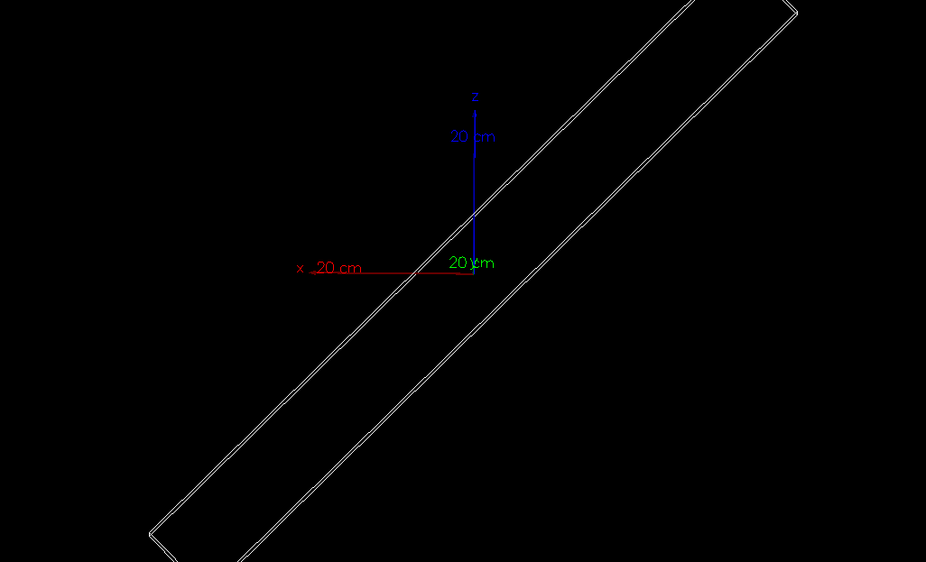
Physical volume
Y axis directed at us, Z axis up, X axis to the left
yRot->rotateY(45.*degree) rotates around Y axis clockwise!

Slide 15
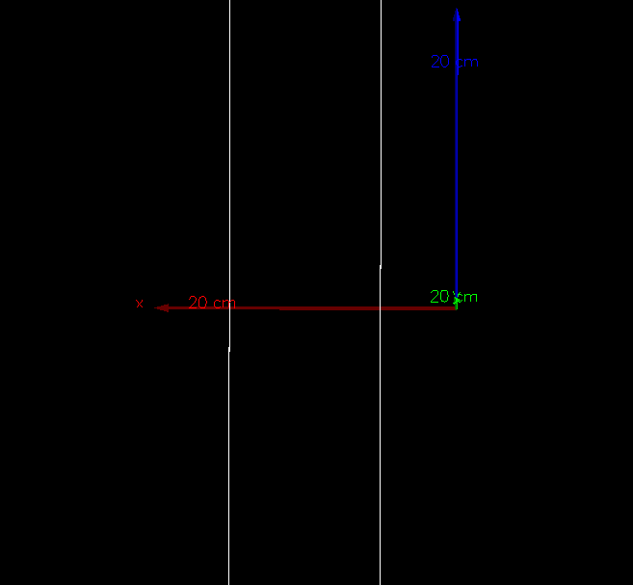
Physical volume
Now let’s remove rotation and look at translation
Setting
auto detectorPV
= new G4PVPlacement(
0, G4ThreeVector(100.*mm,0.,0),
detectorLV,
"DetectorPV",
worldLV,
false,
0,
fCheckOverlaps);
Moves center of the object by 100 mm on X axis - translation sets origin position of daughter frame in mother frame!

Slide 16
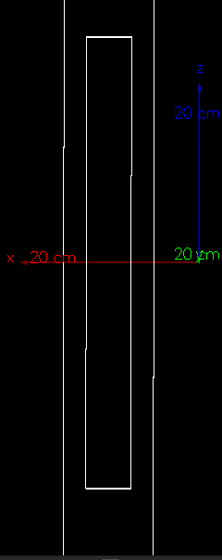
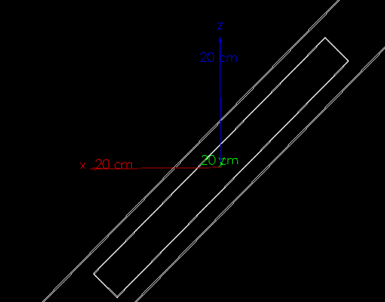
Physical volume
Now let’s add a daughter volume inside
It will rotate and translate together with its mother volume!

Slide 17
Physical volume
If you created a rotation matrix and used it in some physical volume - you should not change it!
You can change translation vector though and reuse it
Also you can use the same logical volume for several physical volumes and set different copy number!
Useful for segmented detectors - pixelated, strip detectors, etc.
You can then differentiate them in your stepping action:
step->GetPreStepPoint()->GetPhysicalVolume()->GetCopyNo();
Much faster than comparing full names for each copy!
If you have copies inside copies — e.g. strips inside modules, modules inside a frame — it only gives you the innermost number. In this case should use this:
auto tch = step->GetPreStepPoint()->GetTouchable();
G4int strip = tch->GetCopyNumber(0); // current volume copy number
G4int module = tch->GetCopyNumber(1); // its mother volume copy number
depth = how many levels up from the current volume, 0 = current
For a really large amount of repeated objects (100+) look at G4PVReplica and G4PVParameterised - the first allows to set many repeated copies, the second allows to change its size, position and material. They use less memory and make navigation faster! We will try G4PVReplica for strip detector in one of the next lectures.

Slide 18
Example: gamma source in a clover Ge detector
We will create clover-like Ge detector with 4 crystals using boolean operations
Also we will create “clover-like” detector from .stl using CADMesh!
Source and physics we take from lecture 3 - a point source of ¹³⁷Cs or ⁶⁰Co gammas
We will get the spectrum of each crystal and of the whole detector

Slide 19
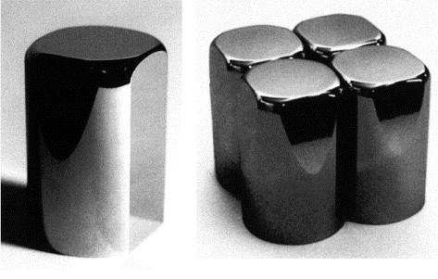
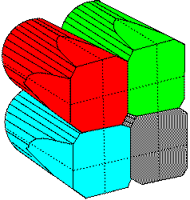
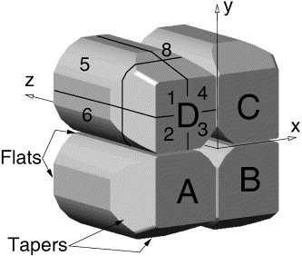
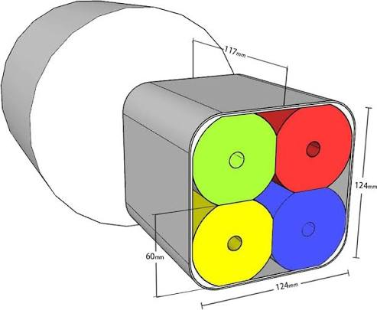
Clover-like geometry
Germanium clover detectors has a specific clover-like shape: 4 “leafs” placed next to each other
We will make something similar in Geant 4
It consist of 4 cylindrical crystals, each with at least 2 machined surfaces to put crystals close to each other
It also typically has a blind hole inside it to put one of the electrodes

Slide 20
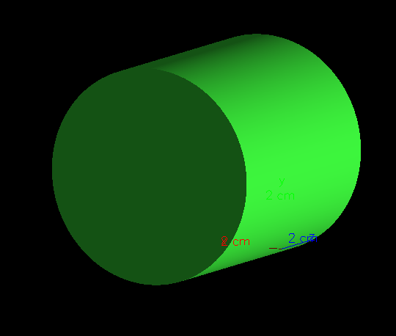
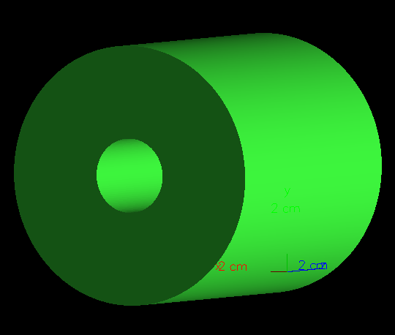
Clover-like geometry
We will start with a simple cylinder - blank
First we will make a hole in it
We make a cut volume - a cylinder with desired diameter and length
Our blank starts from -crystalHalfZ and goes to crystalHalfZ
Our hole goes from z = -crystalHalfZ - overrun to
z = -crystalHalfZ + holeDepth - overrun is added in order for surfaces not to coincide!
See the actual code for it in the example!

Slide 21
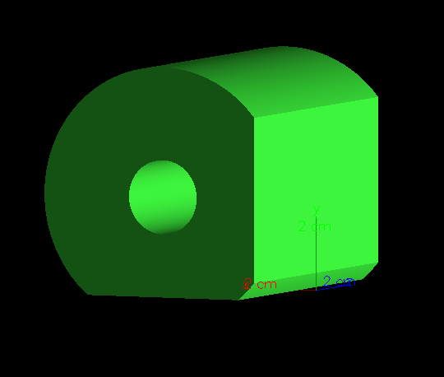
Clover-like geometry
Then we cut from two sides using a large box!
In each subtraction Box covers everything on one side of the cutting plane.
The box is placed by its center, so to put its inner face exactly on the plane x = -flatDist we shift it by
flatDist + cutHalf
where:
flatDist - distance from the center of our original cylinder crystal to the flat face
cutHalf - half-length of out cut box

Slide 22
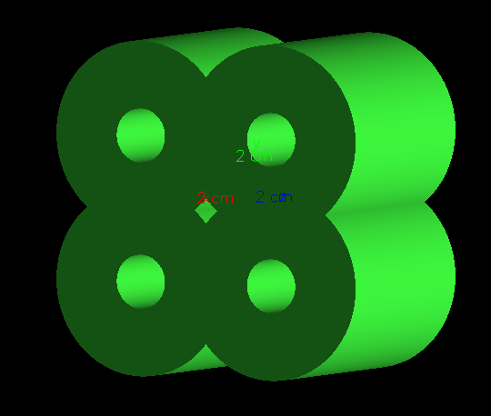
Clover-like geometry
Then we create one logical volume for it and place it 4 times in cycle!
We create a vector of positions to use them in the cycle
We also recreate a rotation matrix pointer each time, and we rotate each around Z axis!
We place it as a copy - in stepping action we can use copy number to differentiate between each leaf
It is a simplified model - real clover detector leaves have more complex shape, have some gaps, some cover, dead layer from each side, etc.
Also LLMs can do all these boolean transformations quite well - this one was done by Claude from the first try with no mistakes

Slide 23
Using CAD geometry
We will use CADmesh
To use it I downloaded CADMesh.hh from here https://github.com/christopherpoole/CADMesh/releases
Then we take some ASCII .stl file - I didn’t find actual clover HPGe geometry, but found some binary .stl file premade for 3D printing and asked LLM to reparse it to ASCII
We put this stl file in the project folder, CMakeLists.txt copies it into the build directory together with vis.mac - clover_ascii.stl in our example
Then we use:
auto mesh = CADMesh::TessellatedMesh::FromSTL("clover_ascii.stl");
.stl files have no units in them - just numbers, CADMesh interprets them as mm - you can rescale and offset the mesh!
auto CloverSolid = mesh->GetSolid() - then you create solid and use it as any other solid in you simulation
It should be watertight - no gaps or holes inside the mesh - every edge must be shared by exactly two triangles - can be checked in python or by LLM
Also this post from one of the developers describes general problems and pitfalls with CAD import: https://geant4-forum.web.cern.ch/t/importing-cad-geometries-into-geant4-practical-notes-and-common-pitfalls/14912

Slide 24
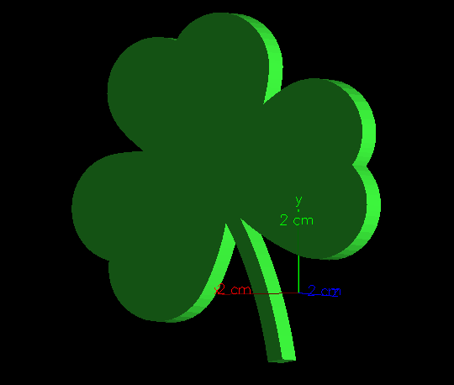
“Clover-like” geometry
Using this .stl you also get a “clover-like” geometry :)
It just an example, but you see the appeal - complex shape, smooth edges, created just by two lines of code - compare with our boolean struggles!
You can switch between boolean clover and stl clover by using flags #define BOOLEAN_CLOVER and #define STL_CLOVER - different volumes will be placed
But remember - complex shapes slow down the navigation and require more RAM

Slide 25
Source from lecture 3
PrimaryGeneratorAction.cc is the same as in lecture 3 - you choose the source with flags on top of the file:
#define Cs137
//#define Co60
Cs137 - one gamma of 661.7 keV in each event; Co60 - two gammas of 1173.2 keV and 1332.5 keV in one event. Enable both - 3 gammas per event
Each gamma gets its own isotropic direction - for ⁶⁰Co we neglect the angular correlation between two gammas
Source is at (0, 0, 0) - not inside germanium, but inside a small cavity! Unphysical, but we will see better how the separate data from leafs colelcts in the total spectrum!

Slide 26
PhysicsList from lecture 3
The same G4VUserPhysicsList built from scratch, the same EM parameters and 1 um cuts
Photoelectric effect and pair production are switched on:
ph->RegisterProcess(new G4PhotoElectricEffect(), particle);
ph->RegisterProcess(new G4ComptonScattering(), particle);
ph->RegisterProcess(new G4GammaConversion(), particle);
Pair production is possible only above 1022 keV - it is small, but it is there for ⁶⁰Co gammas
No hadrons, no ions, no decay - we don't need them for gammas.

Slide 27
Data collection
RunAction creates 5 histograms: LeafSpectrum_0 ... LeafSpectrum_3 and TotalSpectrum, 3000 bins from 0 to 3000 keV - 1 keV per bin
Output file is gamma_spectrum_<run number>.root, histograms are reset at the beginning of each run
In SteppingAction we check that the step is in a crystal and take the leaf number from the copy number:
auto* pv = step->GetPreStepPoint()->GetPhysicalVolume();
if (pv->GetName() != "CrystalPV") return;
auto leaf = pv->GetCopyNo();
fEventAction->fLeafs[leaf]+=edep;
fEventAction->fTotal+=edep;
All 4 copies have the same name - so the name only tells us that we are in germanium, copy number tells which leaf
In EndOfEventAction each leaf histogram gets the energy deposited in this leaf, TotalSpectrum - the sum of all leaves

Slide 28
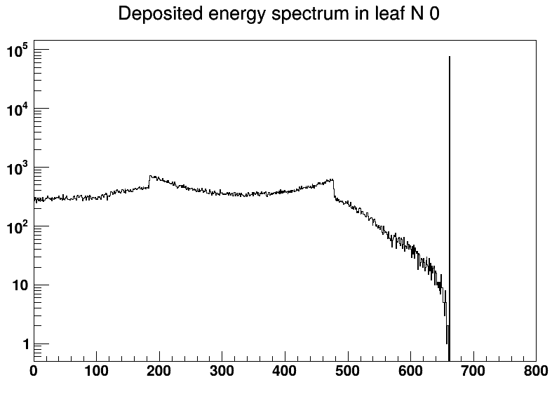
Results: one leaf
10⁶ events of ¹³⁷Cs, boolean clover, source in the center
Full energy peak at 661.7 keV - it is in a single 1 keV bin! Geant4 knows nothing about energy resolution, charge collection or electronics - you add it yourself later
Compton edge at 477.4 keV: E·2E / (mc² + 2E)
Bump at ~184 keV - backscattering: 661.7 - 477.4 = 184.3 keV. There is nothing around our detector - these photons scattered back from the neighbouring leaves!
Between the Compton edge and the peak - several Compton scatterings in the same leaf
~76 thousand counts in the peak of each leaf

Slide 29
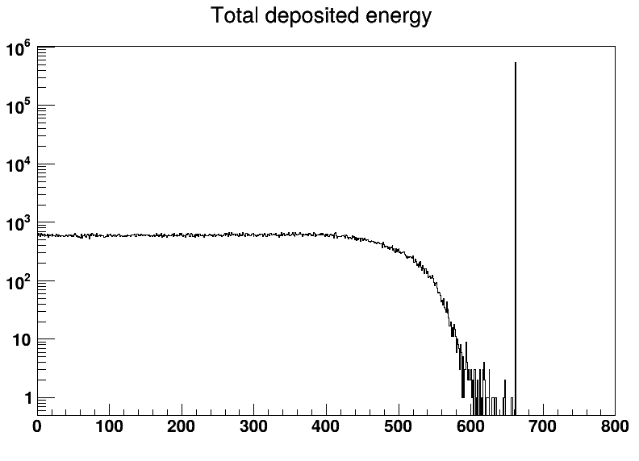
Results: whole clover
TotalSpectrum - sum of all leaves in one event
Full energy peak - 537 thousand counts, 1.77 times more than the sum of four leaf peaks (303 thousand)!
Gamma often scatters in one leaf and is absorbed in another one - each leaf sees only a part of the energy, but the sum is the full energy
That's the idea of clover: sum up the leaves hit in coincidence - so-called add-back. You get efficiency of a big crystal and still know which leaves were hit
Compton edge is washed out and the backscatter bump is gone - backscattered photon is summed with the first deposit
53.7% of all emitted gammas are in the full energy peak - our source is almost inside the detector

Slide 30
Some homework if you like
Switch the source to ⁶⁰Co. Find the sum peak at 2505.7 keV in TotalSpectrum. Why does it appear? Is it in leaf spectra too?
Move the source out of the clover - for example 1 cm in front of the front face, (0, 0, 50*mm). Compare efficiency, form of spectra and add-back factor with the source in the center.
Make leafs overlap. Put the leaves 1 mm closer to the center: use d = flatDist - 1*mm for positions. Run with fCheckOverlaps = true and see the warning. Then try /geometry/test/run in UI.
Add a dead layer of 200 um to the crystals. There are several ways to do it. One of the ways - create a solid representing an active area and place it as daughter volume in the original crystal. Change SteppingAction accordingly.
Put the clover in an aluminium end cap - 1 mm of G4_Al around all leaves. What changes in the spectra when the source is outside?

